Slide 1

Notes:
Do you know how much optimally your organization is running.
Do your employees know, how much optimally they are working.

Slide 2

Lets introduce you to a powerful solution for it

Slide 3
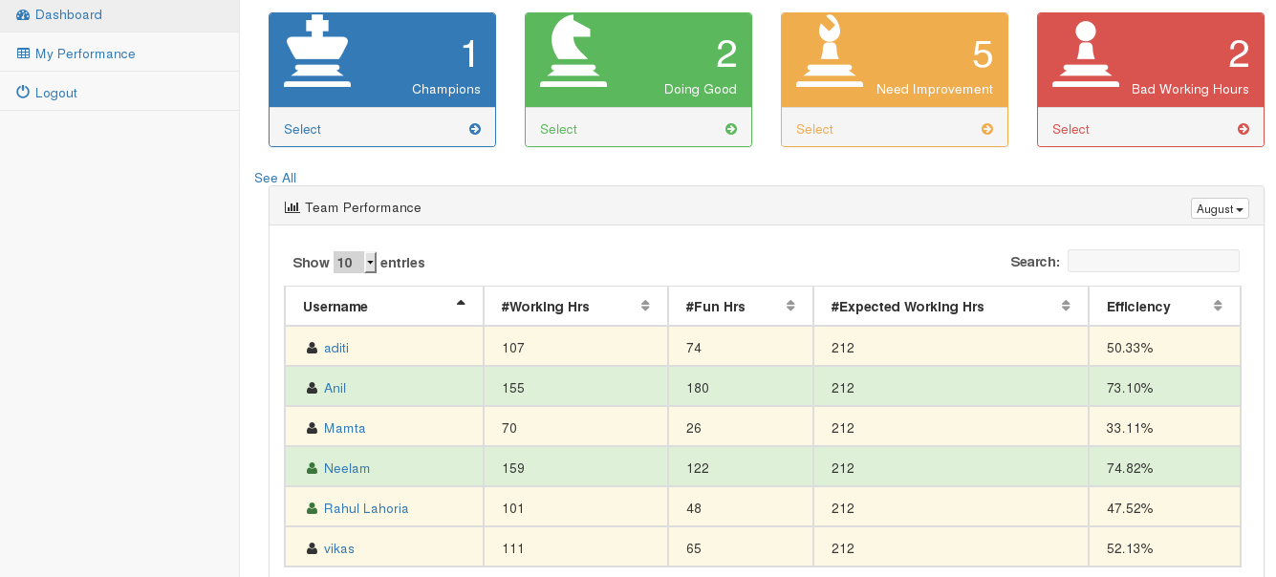
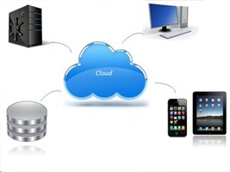
Ncy & Bulldog
Notes:
Ncy & Bulldog a SAAS cloud based solution, Gives you a complete report to know where your organization's employees time got spent, you can also get right ROI.
your employees can also see where they are spending their time.

Slide 4
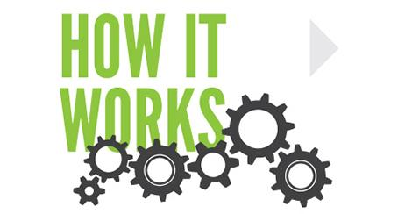

Slide 5

Step 1.
Just Sign up for the services

Slide 6

Step 2.
Download Bulldog

Slide 7
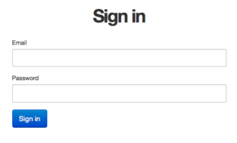
Step 3.
Sign In
Ncy & Bulldog

Slide 8


Slide 9
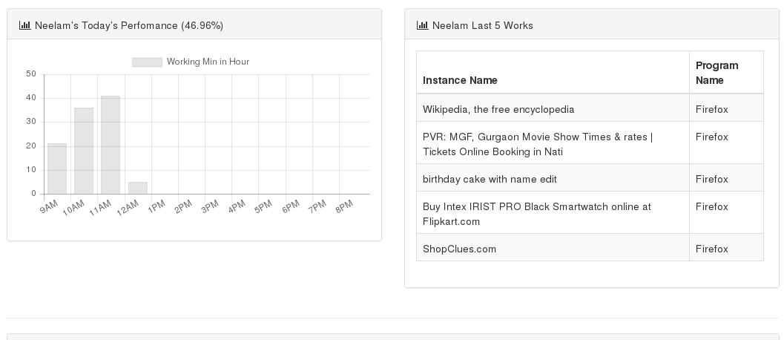
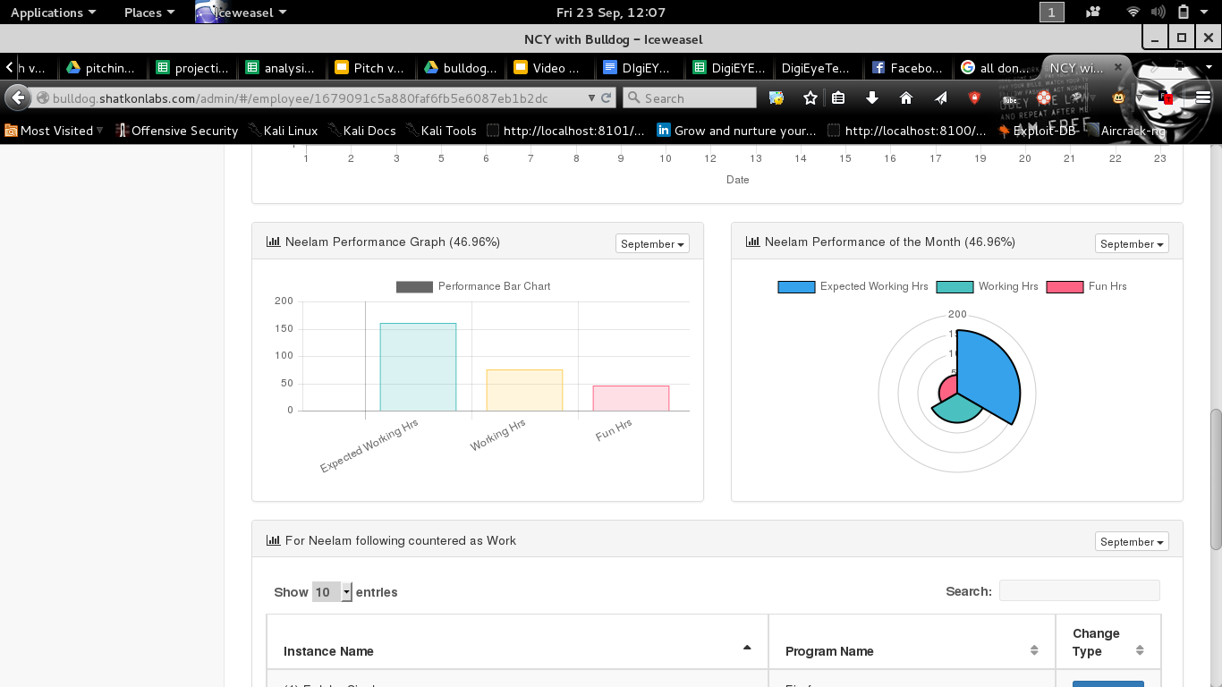
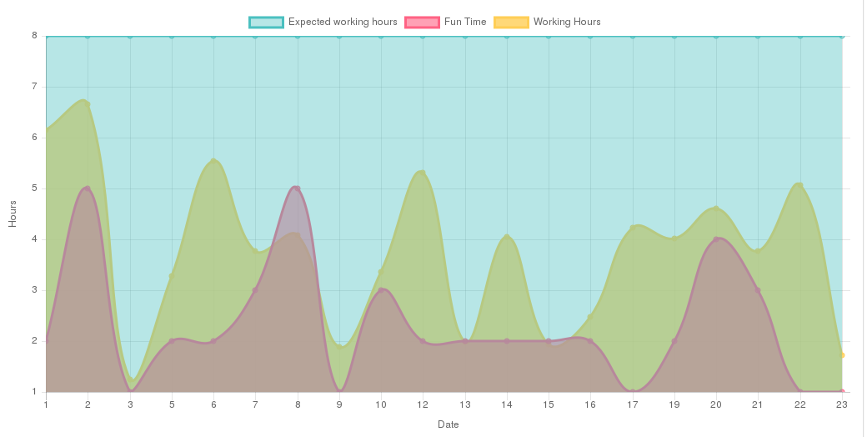
Notes:
Now user can start analysing the reports using dashboard after 15 mins.
You can even find out who needs to learn, who is not working well & who can take more load.

Slide 10


Ncy & Bulldog can start saving time & money for your organization
Employees enjoy Work life balance
Notes:
Ncy & Bulldog can start saving time & money for your organization.
And employees enjoy Work life balance

